Slide 1
Mapping Influence and Evolution in AI Research: A Citation Network Analysis of Top Universities (2015–Present)
By- Jinxi Hu, Johanes Panjaitan, Yuxuan Sun, Samarth Grover

Slide 2
Team Contribution
Jinxi Hu: Write the methology part of report, did data set clean and basic network analysis.
Johanes Panjaitan: Putting together final report draft, did connected network analysis
Samarth Grover: Wrote introduction and literature review section of report, did part of the initial network statistics analysis
Yuxuan Sun: Collected initial data, analyzed the community structure of the full directed graph, as well as k-core decomposition and network robustness, wrote the Abstract and Conclusion sections for final report.

Slide 3
Introduction
Research topic：
Citation network analysis of AI research at top universities.
AI-related papers from the ten most research-active universities (2015–2025).
Model each paper as a node and each citation as a directed edge to study how influence and collaboration are structured.
Research movement：
AI research has expanded rapidly in the past decade, from traditional machine learning to deep learning and large language models.
Top universities produce a large share of highly cited AI papers that shape global research agendas.
Citation-network methods are increasingly used to “map science”, revealing hidden structures, subfields and cross-disciplinary links (e.g., AI in healthcare, education, law).

Slide 4
Research Questions
1. Which paper is the most impactful?
2. What subtopics have the highest concentration of research?
3. Which institution has the most research output?
4. What is the oldest paper that has sustained relevance?
5. Where is the newer research headed?

Slide 5
Related Work
Bibliometric Studies of AI Research：
Mardiani & Iswahyudi (2023)
Mapped global AI publication growth using VOS viewer(1974–2023)
Identified thematic clusters and country-level output
Limitations: Very broad timeline; no institutional comparison; misses impact of LLM era
Fan et al. (2024)
Bibliometric review of 5,000+ LLM papers (2017–2023)
Characterized rapid growth and interdisciplinarity in LLM research
Limitation: No citation network analysis or structural evaluation of influence

Slide 6
Related Work
Citation Network & Impact Metrics Research：
Costa & Frigori (2024)
Modeled AI citations as complex systems
Identified structural shifts over time using entropy & degree changes
Limitation: Global view only; no institutional structure or community mapping
Fiala & Tutoky (2017)
Compared PageRank vs citation counts for predicting influential researchers
Finding: PageRank better captures true impact
Limitation: Author-based analysis; not applied to AI subfields or institutions

Slide 7
Research Gap & Contribution of This Study
Gaps in Existing Literature:
Existing datasets end before LLM-driven paradigm shift (2022–2024)
No study focuses on top universities as the unit of analysis
Limited studies using Citation networks (with PageRank, centrality metrics & Community detection)
No analysis of bridge papers connecting disparate AI subfields
Our Study:
Provides a decade-long structural view of AI research evolution, with focus on LLMs
Highlights top 10 institutions to reveal influence distribution
Builds a directed citation network (2,610 papers, 3,757 citations) and applies:
PageRank, betweenness, closeness
Louvain community detection
Temporal analysis (2015–2025)

Slide 8
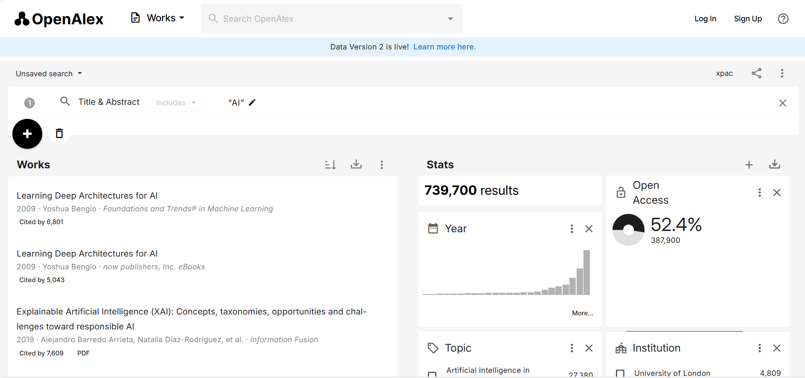
Methodology: Data source
All data we use are from websit OpenAlex (openalex.org)
An open, free, and globally comprehensive index of scholarly publications.
Can provide article informations and citation relations as data set.

Slide 9
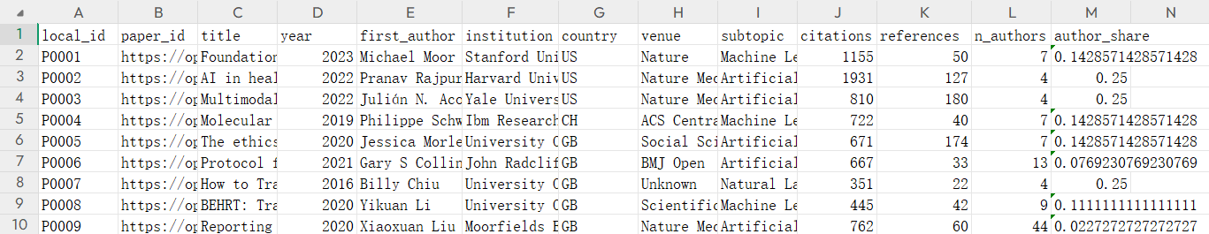
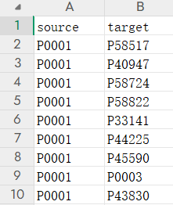
Methodology: Data source
Article data set include article’s subtopic and institutions.
Articles are treated as Nodes.
Total over 60000 articles are collected, but most are empty.
We clean up those empty articles and their related citations.
Citations are treated as Direct Edges.

Slide 10
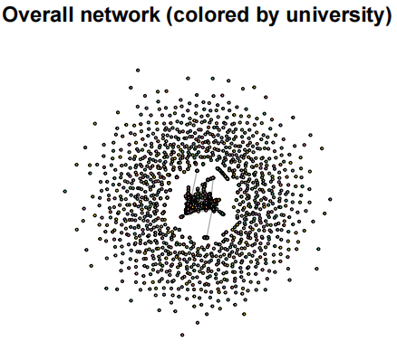
Data analysis - cleaned raw data
Total number of articles in data set: 2160
Number of citation relations: 3722
Many isolated nodes surround the biggest connected component.
Those nodes actually cite articles which published before 2015
Number of isolated nodes: 1028

Slide 11
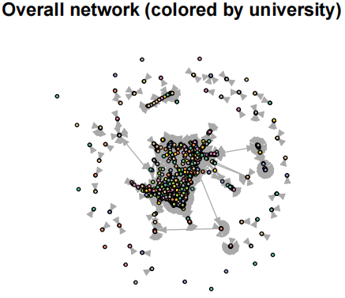
Data analysis - cleaned raw data
The network which only include none-isolated nodes is what we will do further analysis on it.
Isolated nodes can not form network
Total number of non-isolated nodes: 1582
Total edges: 3722

Slide 12
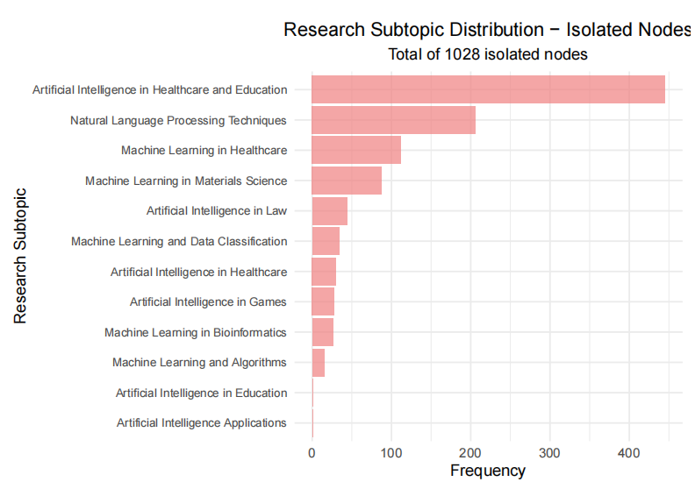
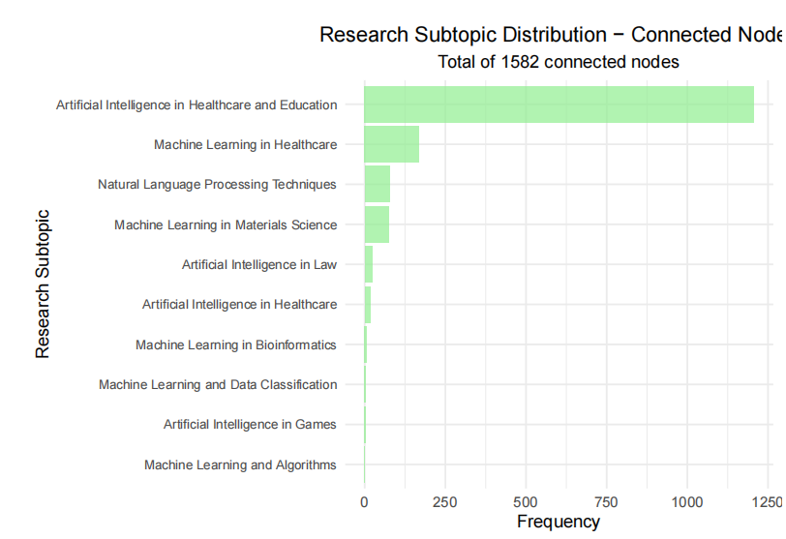
Data analysis – data distribution
Articles in none isolated set: 1582
Articles in isolated set: 1028

Slide 13
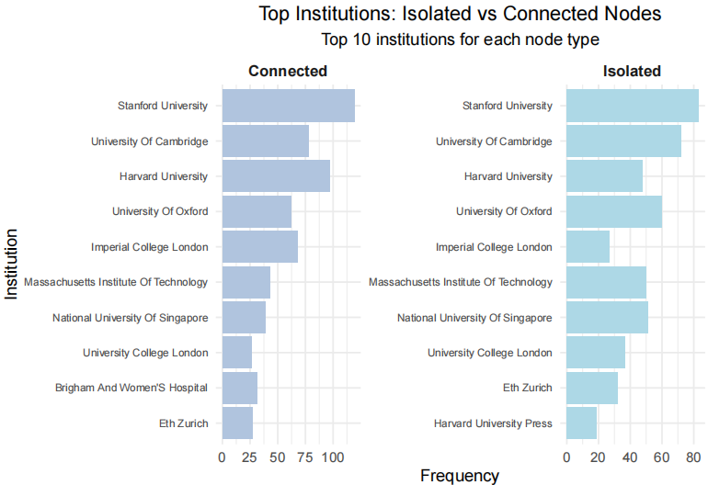
Data analysis - data distribution
In our data sets Connected Nodes and Isolated Nodes show similar distribution in both subtopic and institutions.
AI in Helath and Education is the most popular research topic in last 10 years.
Stanford University publish most of articles, followed by University Of Cambridge and Harvard University.

Slide 14
Data analysis - deeper in connect nodes set
We caculate out the In and out degree of nodes in connect nodes set.
Find out components and focus ont he biggest component.
Biggest component include 1433 nodes which is 90% of connected nods.
Parameters we focus on:
page rank, in degree, betweenness and cloness centrality.
for find noddes influence
community and K-core.
for find out concentration of nodes

Slide 15
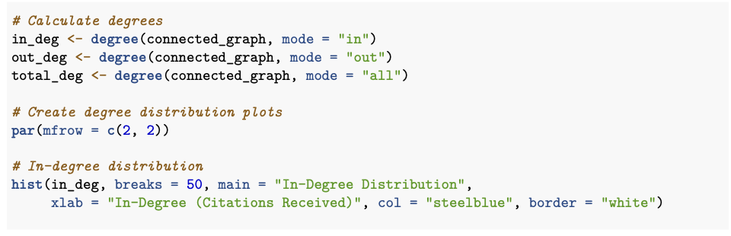
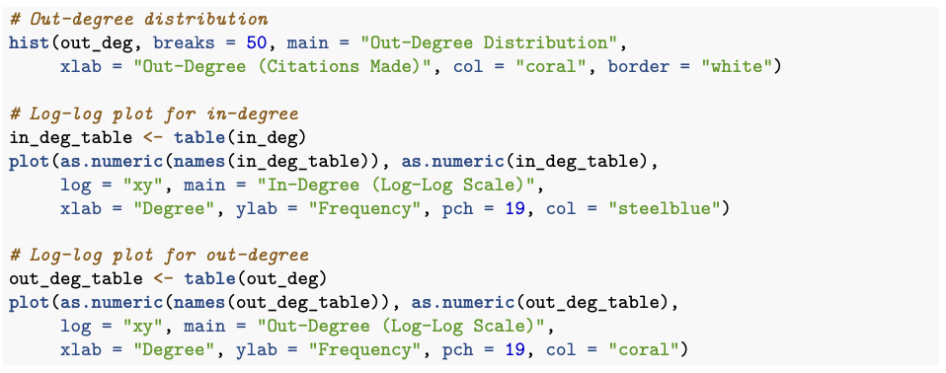
Degree Distribution

Slide 16
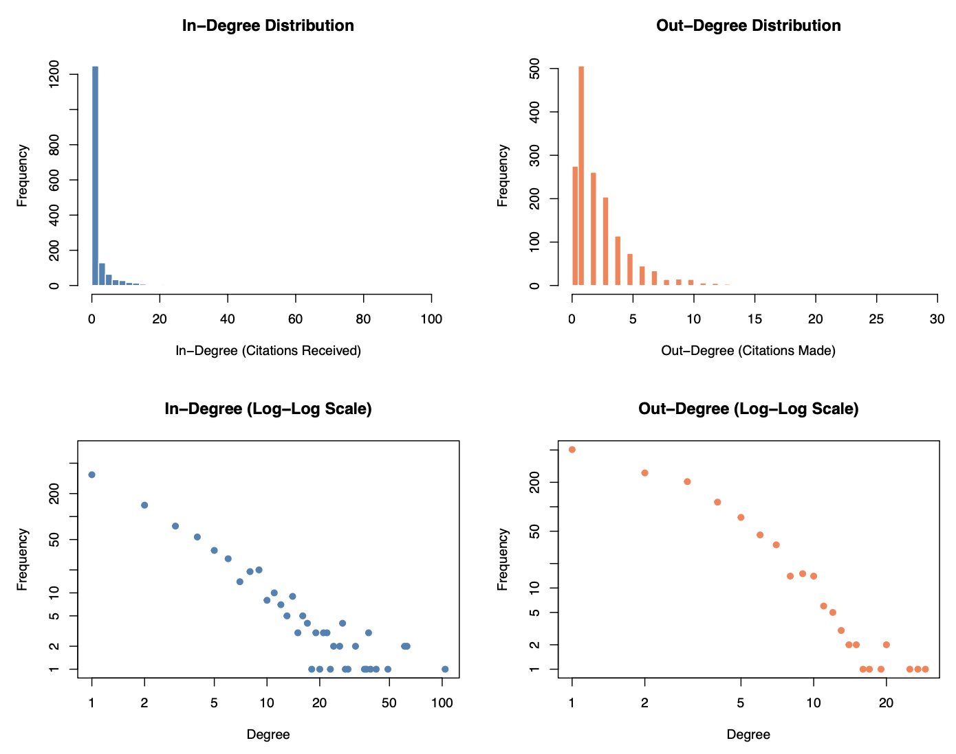
Degree Distribution
Notes:
Most nodes in and out degree is distributed in low level and show up a long tail feature. At the same time the log plot of in and out degree also show that our data set fit the power law.

Slide 17
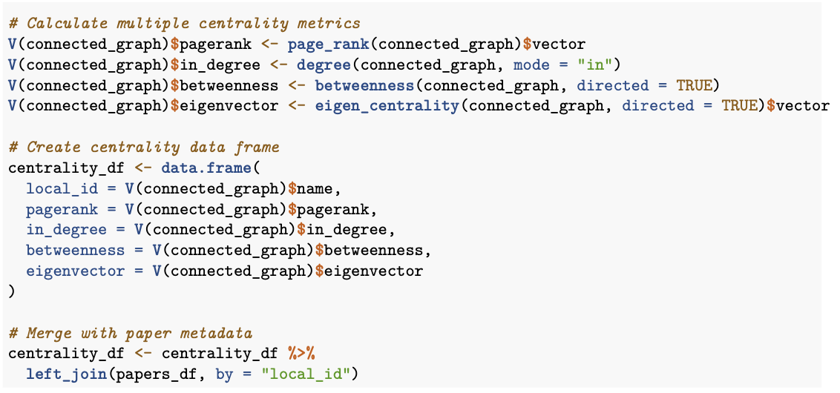
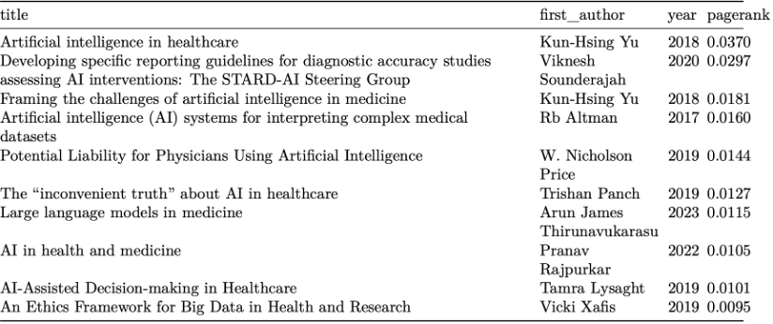
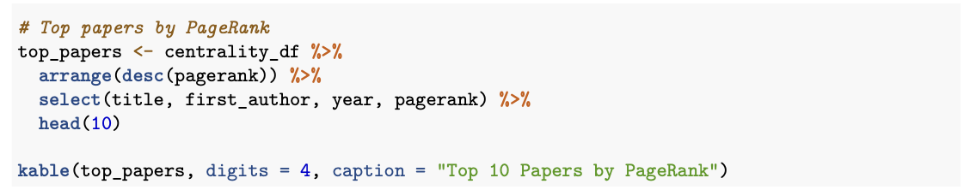
RQ1: Most impactful paper

Slide 18
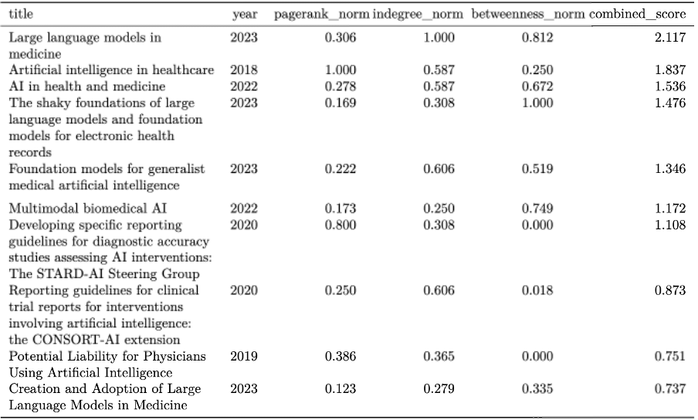
Most impactful papers combined metrics

Slide 19
RQ1: Most Impactful Paper
Key Findings:
Can be observed that most of the papers with highest pagerank is in the subtopics of healthcare, such as AI in interpreting medical datasets, medicine, diagnostic accuracy, etc.
The subtopics of AI in healthcare is the most influential
Most of them are from around 2018 period.

Slide 20
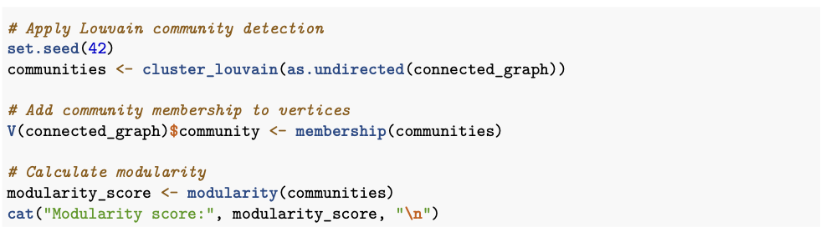
RQ2: Which subtopics has highest concentration of research

Slide 21
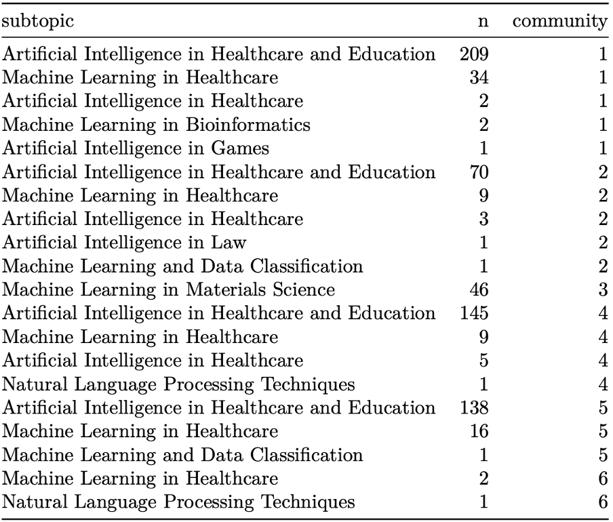
Key Findings
Can be observed from the table, AI in Healthcare is the most dominant topic in the research communities with highest concentration of papers.
The existence of a few different subtopics in one community (such as AI in Games, Material Science, Law) shows interdisciplinary collaboration.

Slide 22
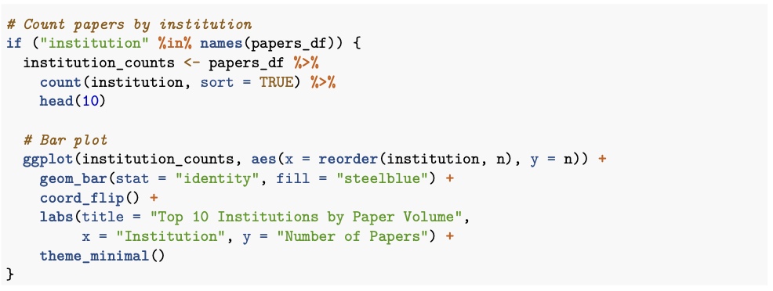
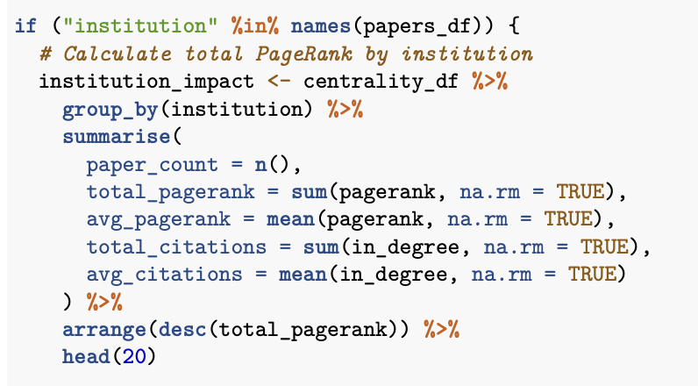
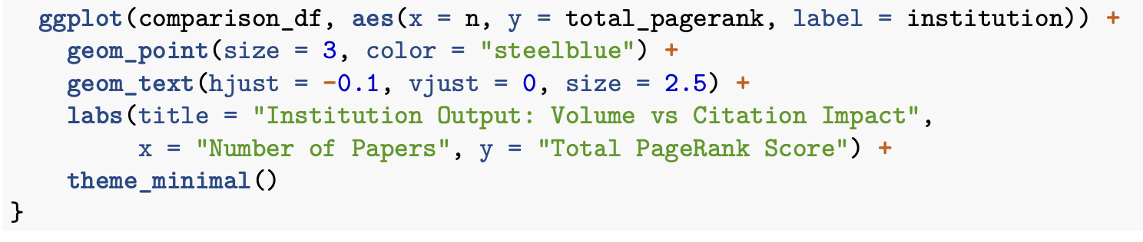
RQ3: Which institution has the most research output?

Slide 23
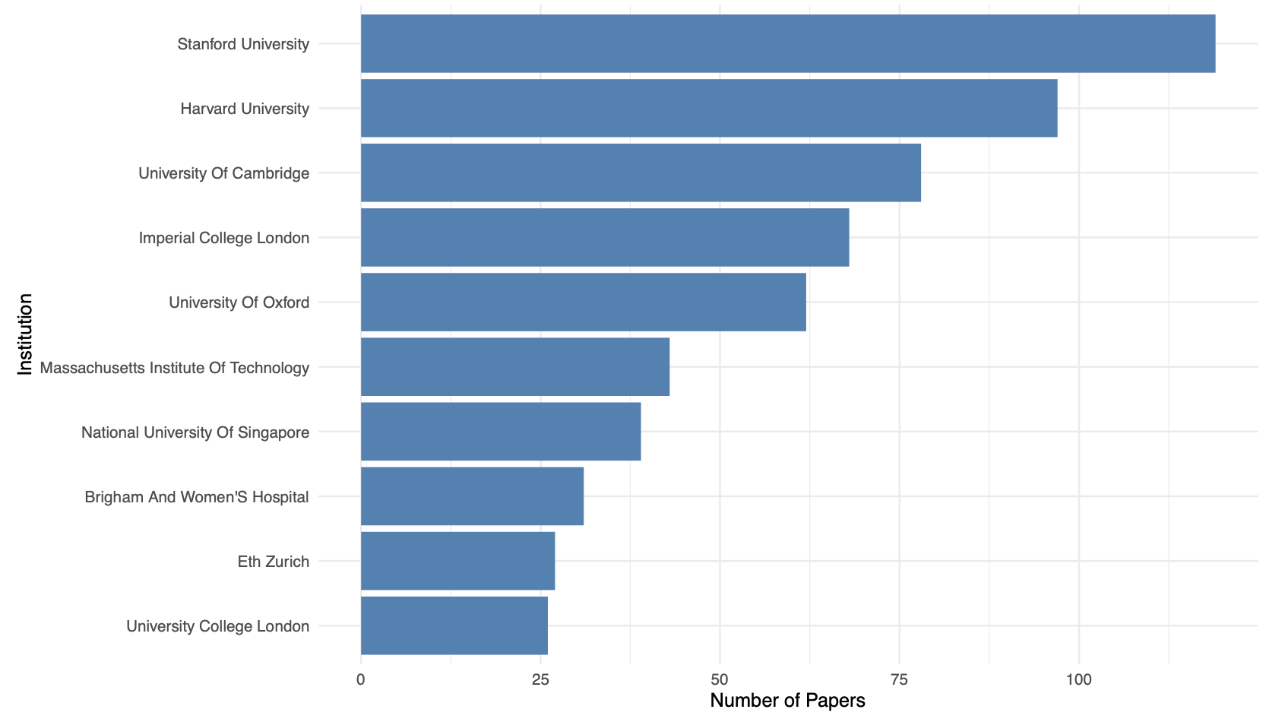
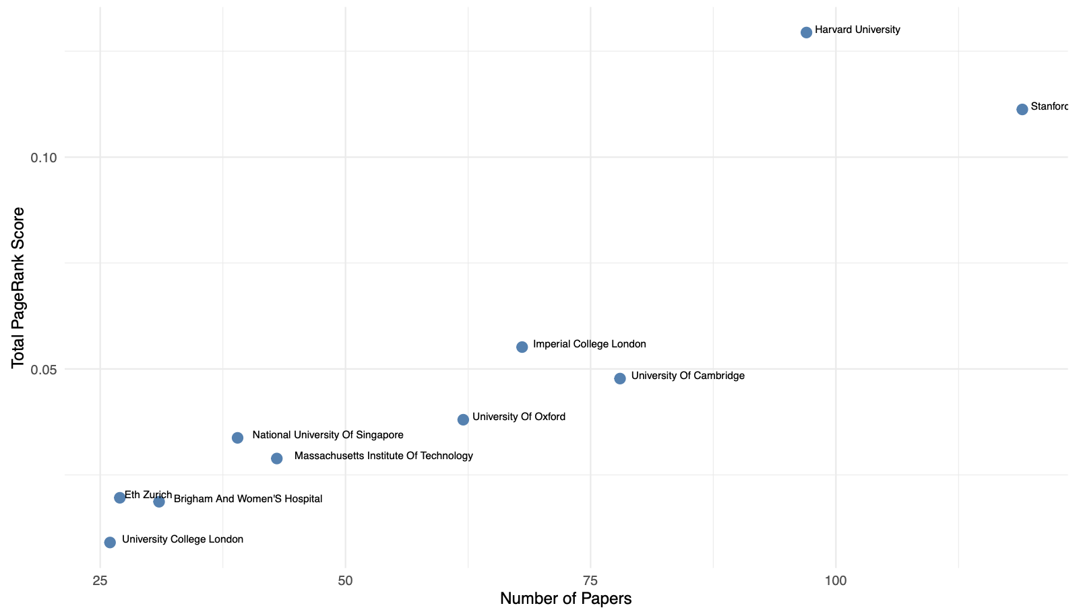
RQ3: Which institution has the most research output?
Key Findings:
Stanford leads in terms of number of papers. However, with the total PageRank numbers, harvard leads with the highest pagerank.
Publication quantity does not equal quality
Research impact of a university depends more on how other influential papers cited that paper, not just a volume of papers.

Slide 24
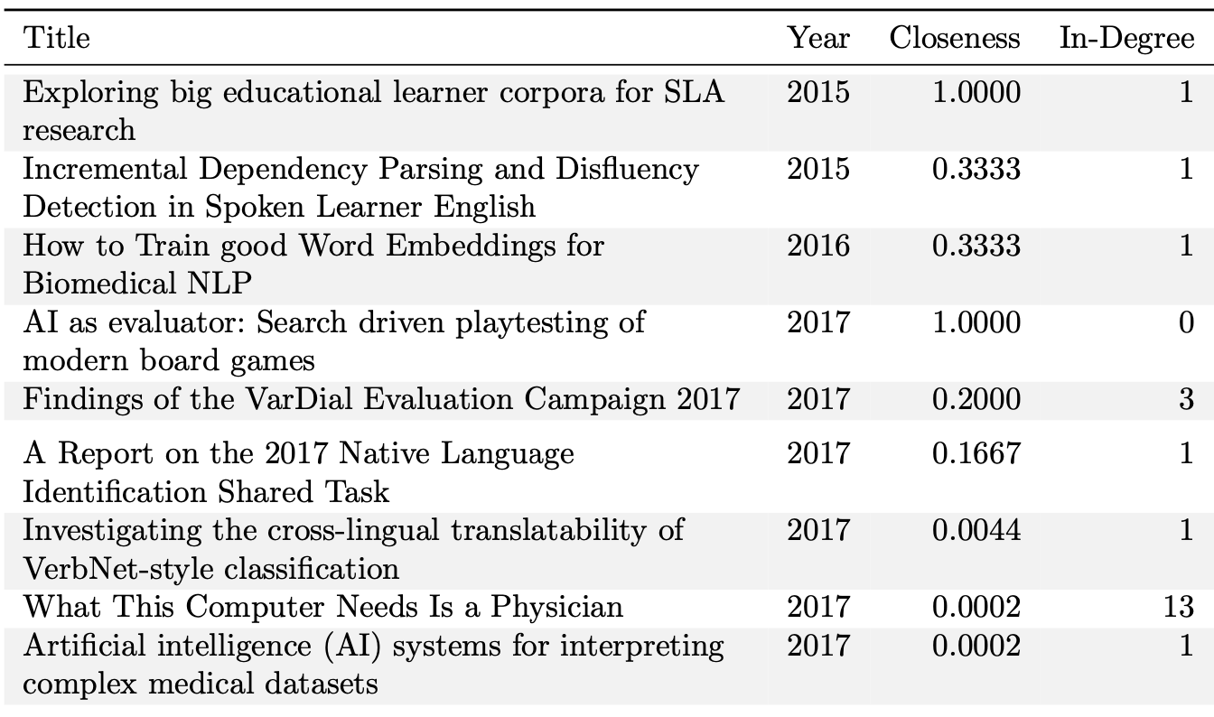
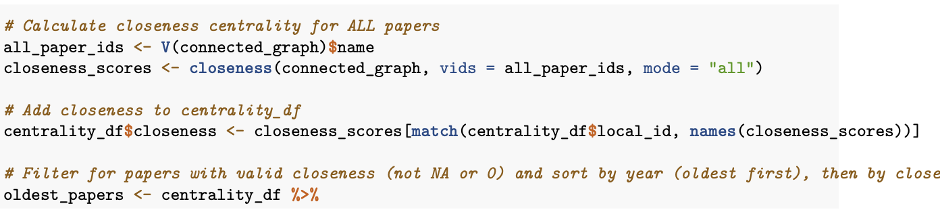
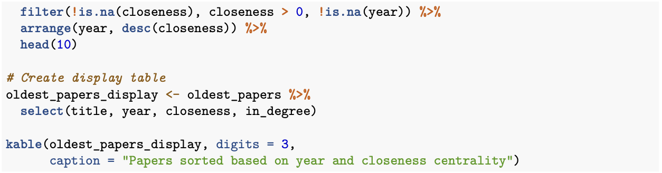
RQ4: What is the oldest paper that has sustained relevance

Slide 25
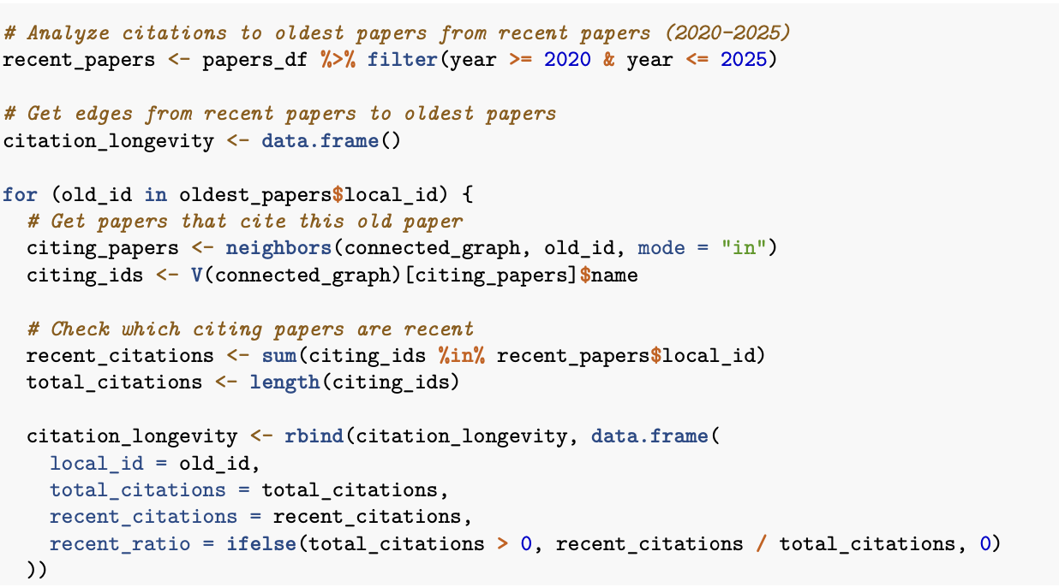
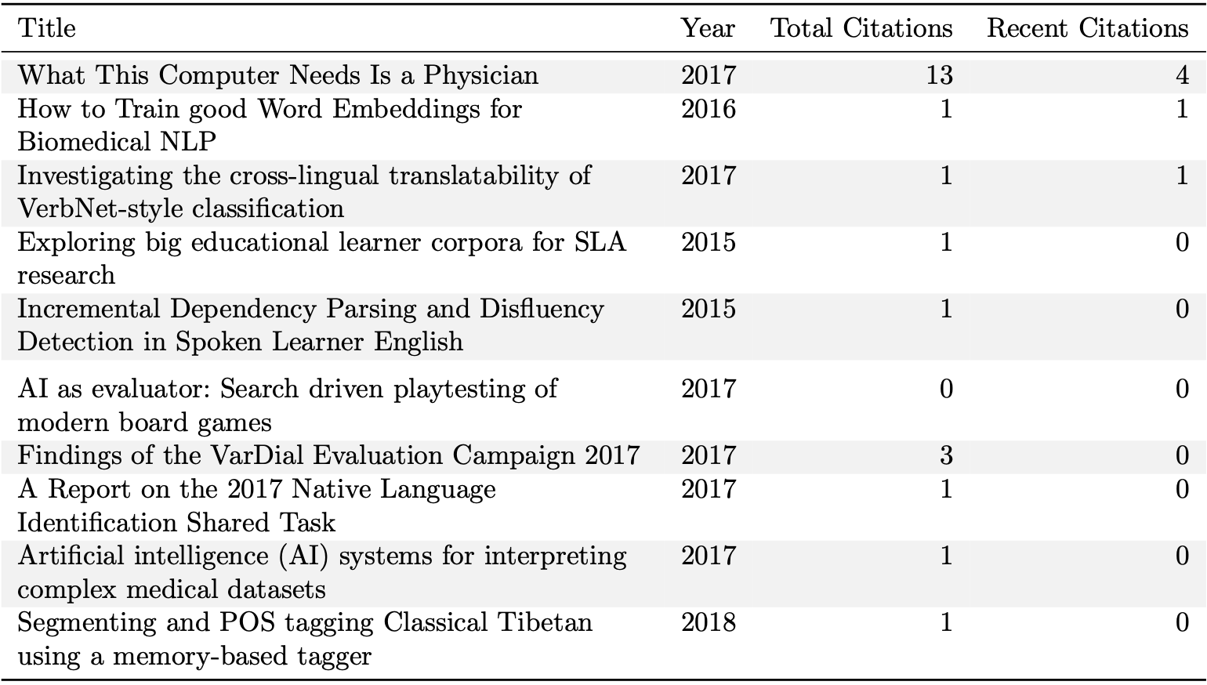
RQ4: What is the oldest paper that has sustained relevance

Slide 26
RQ4: What is the oldest paper that has sustained relevance
We identified foundation papers from 2015-2018 that receive citations from recent work (papers that are published from 2020-2025) and maintain high closeness centrality.
Key Findings:
These papers remain central to ongoing research discussions

Slide 27
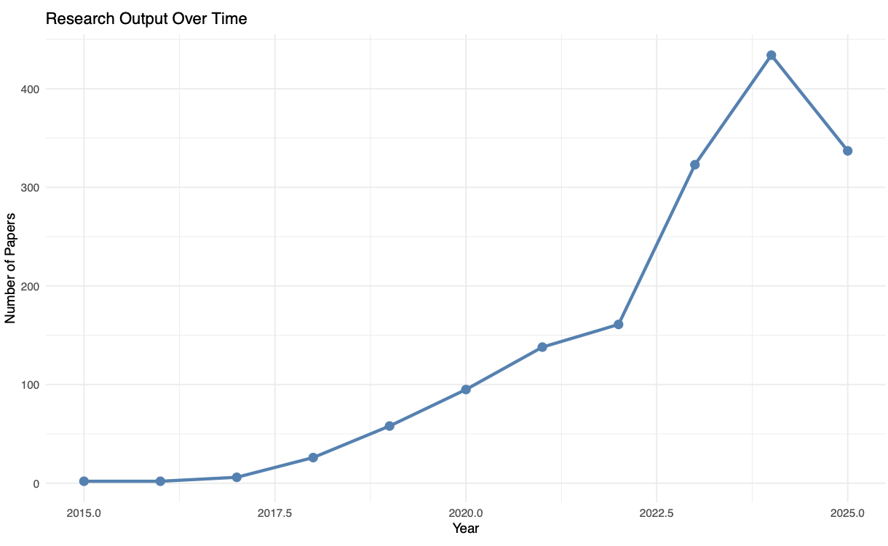
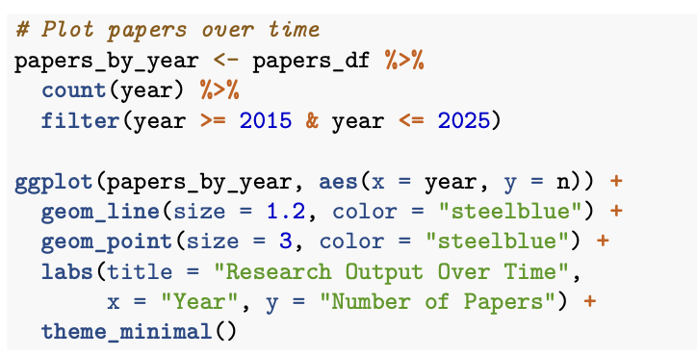
RQ5: Where is the newer research headed?

Slide 28
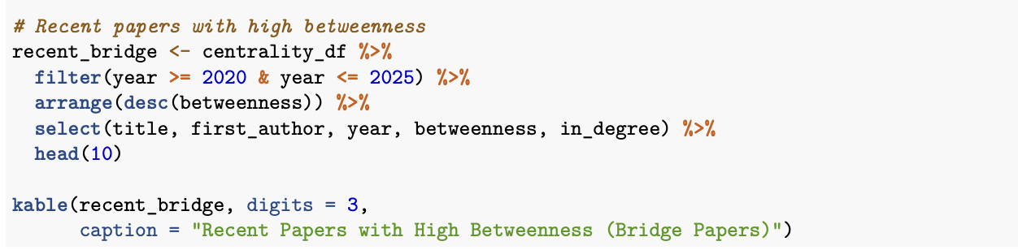
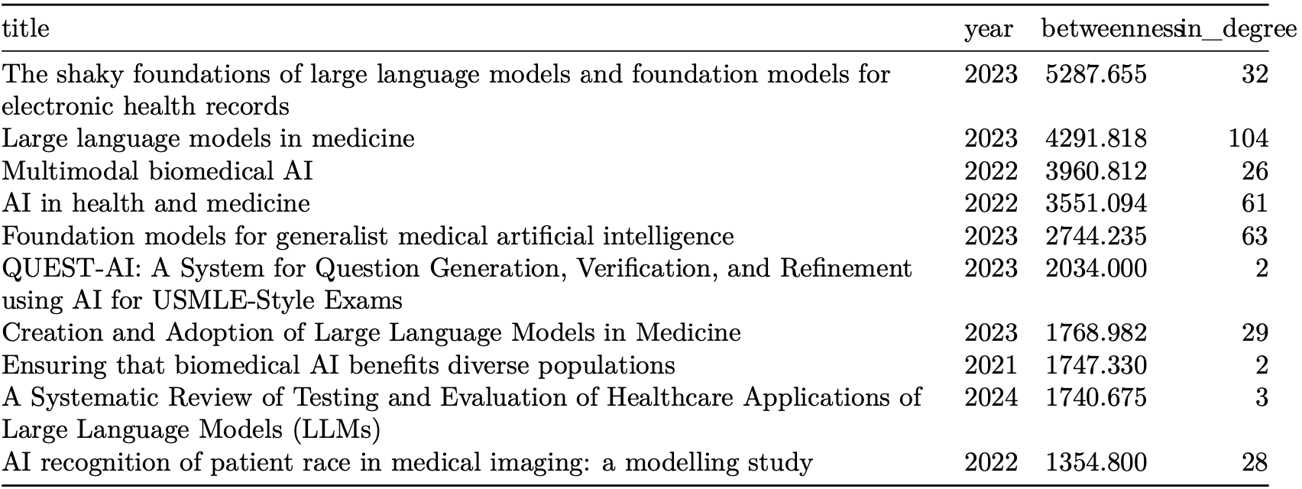
RQ5: Where is the newer research headed?
Notes:
Newer research headed to the application of LLM and AI for Health and medicine research. It also headed toward interdisciplinary collaboration between AI, LLM, and Health, educational technology.

Slide 29
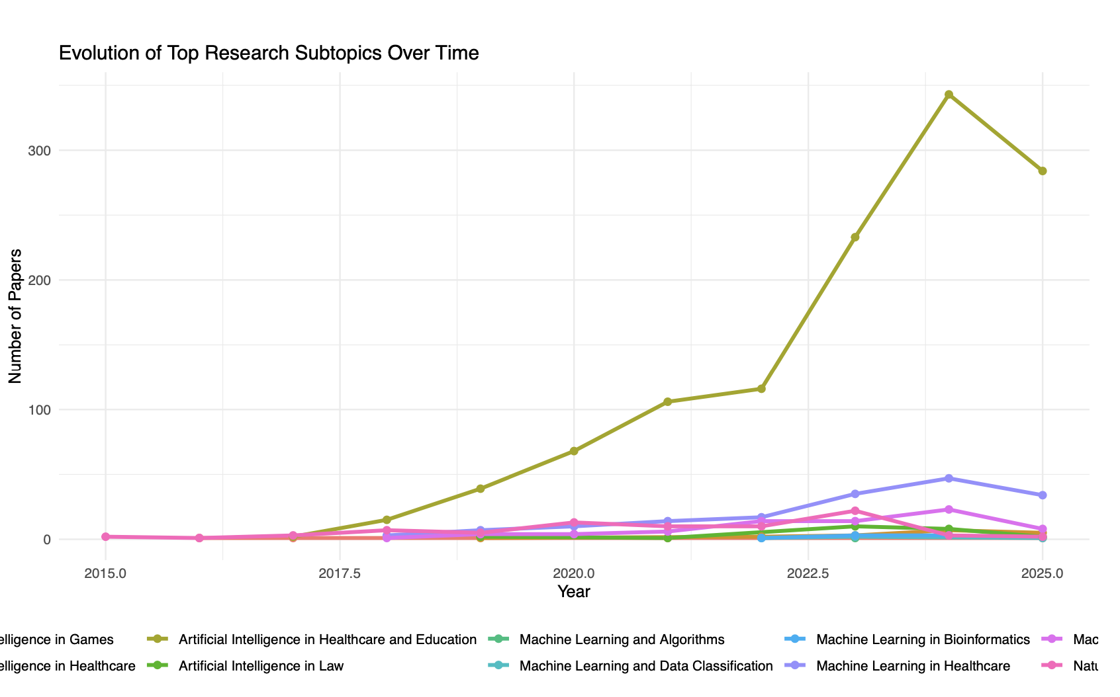
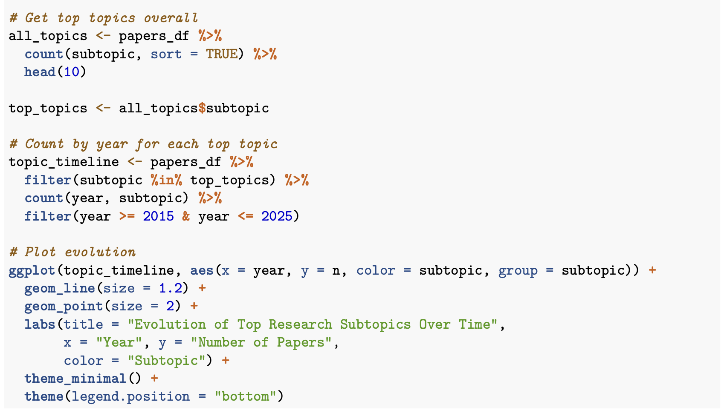
RQ5: Where is the newer research headed?

Slide 30
Conclusion
AI citation networks at top universities are scale-free: a small number of hub papers concentrate most of the influence.
Research impact does not simply follow publication volume; some universities achieve high influence with fewer but more central papers.
Recent work – especially AI in healthcare and large language models – drives explosive growth and connects previously separate research communities.
Overall, AI research is shifting toward interdisciplinary, application-oriented work, and future influence will depend less on how many papers are published and more on producing trend-setting papers that bridge diverse domains.

